Slide 1

SAE Formula
Chassis
Gustavo Ruiz​ – Chassis Lead & CAD Engineer
Brandon Guzman​ – Test Engineer & Firewall designer
Ryan Meger – FEA and Rear Box Engineer​
Alexandra Brister – Cockpit Engineer​
Carson Kent​ – Aerodynamic Engineer

Slide 2

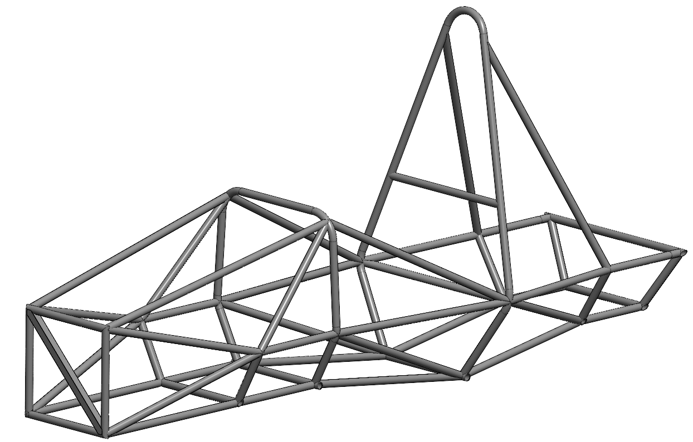
Project Description
FSAE Chassis
  Overview: Design & Fabricate a lightweight, high-performance chassis for FSAE car, ensuring structural integrity, safety, and compliance with FSAE regulations
  Key Objectives
    Torsional Rigidity: Improve handling & stability
    Lightweight: Balance weight with strength
    Safety Compliance: Meet FSAE rules for driver protection
  Significance: The chassis forms the foundation of the car, impacting all other performance aspects, including handling & safety.
Research
Develop Design Strategy
Build Prototype
Test Prototype
Refine & Improve Design
PHOTO
GR

Slide 3
QFD
Customer Requirements
Engineering Requirements
Increased Cockpit room
Compliant Primary Structure Tubing
Removeable Firewall
Aerodynamic Components
Pedal Box for 3 Pedals
Reduced Rear Suspension Box Length
5, 6, or 7-Point Harness Compatibility
Secure Front Bulkhead Integration
Shielded fuel tank from impacts
Front aero ≤ 700mm forward of front tire
Rear Aero ≤ 250mm rearward of rear tire
Cockpit accommodates driver template
Bend Radius = 3x outer diameter
SIS Frame members: Size B tubing
Front Hoop: Size A tubing
Head Restraint to withstand forces of 900N in rearward direction and 300N in lateral
Driver Helmet is min. of 50mm from line drawn from top of both hoops
Front Hoop ≤ 250mm forward of steering wheel
Main hoop braces ≤160mm below main hoop top
Main hoop: continuous, Size A tubing
Main Hoop Brace angle ≥ 30॰
Main hoop ≤ 10॰ from vertical
GR

Slide 4
Engineering Requirements
ER | Target Value | Units | Relation to CRs
Bend Radius | 3x outer diameter | Inches | Ensure Structural Integrity & Safety
SIS Frame Members | 1.0” x 0.065” | Inches | Meets Safety Standards complying with Structural Requirements
Front Hoop | 1.0” x 0.095” | Inches | Critical for Safety & Compliant Primary Structure
Head Restraint | 900N rearward, 300N lateral | Newtons (N) | Protects Driver & Harness Compatibility
Helmet Clearance | ≥ 50mm from Top of hoops | Millimeters (mm) | Ensure Driver Safety relating to cockpit room
Front Hoop Position | ≤ 250mm forward of steering wheel | Millimeters (mm) | Maximize Cockpit Space while maintaining safety
Main Hoop Braces | ≤ 160mm below main hoop top | Millimeters (mm) | Support Structural Integrity & Compliant Primary Structure
Main Hoop | Continuous Size A Tube | Inches | Reduces failure points & Compliant Primary Structure
Brace Angle | ≥ 30॰ | Degrees (॰) | Supports Aero Components & Reduce Rear Suspension Box
Main Hoop Angle | ≤ 10॰ from vertical | Degrees (॰) | Ensures Optimal performance, essential for cockpit design
GR

Slide 5
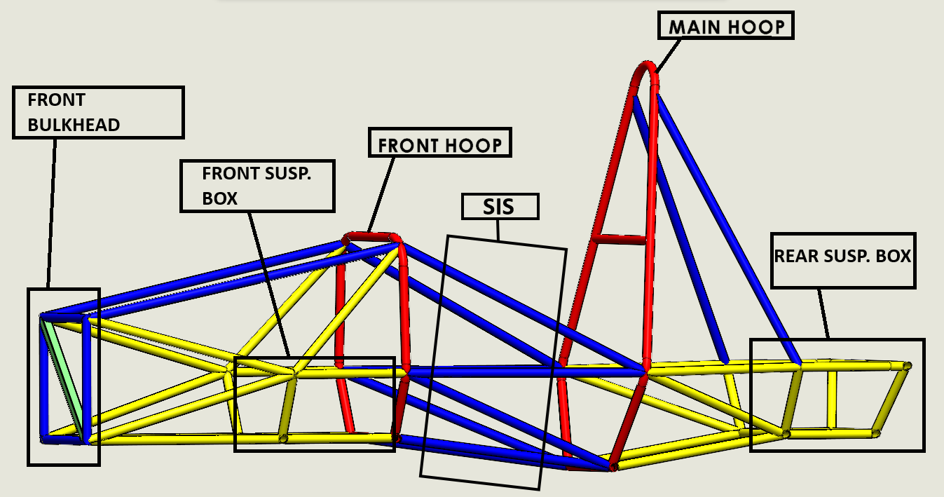
Chassis Frame V1.4
Chassis Labeled Drawing
Front Hoop: Supports driver safety & structural integrity
Main Hoop: Provide structural strength & safety anchor
Front Bulkhead: Crash Protection for driver’s feet
Front Susp. Box: Mounting Point for Suspension Components
Rear Susp. Box: Mounting Point for Suspension & Drivetrain Components
Side Impact Structure (SIS): Absorb Side Collison forces.
PHOTO
PHOTO
 | Size A | 1" x 0.095"
 | Size B | 1" x 0.065"
 | Size C | 1" x 0.049"
 | Size D | 1.375" x 0.049"
GR

Slide 6
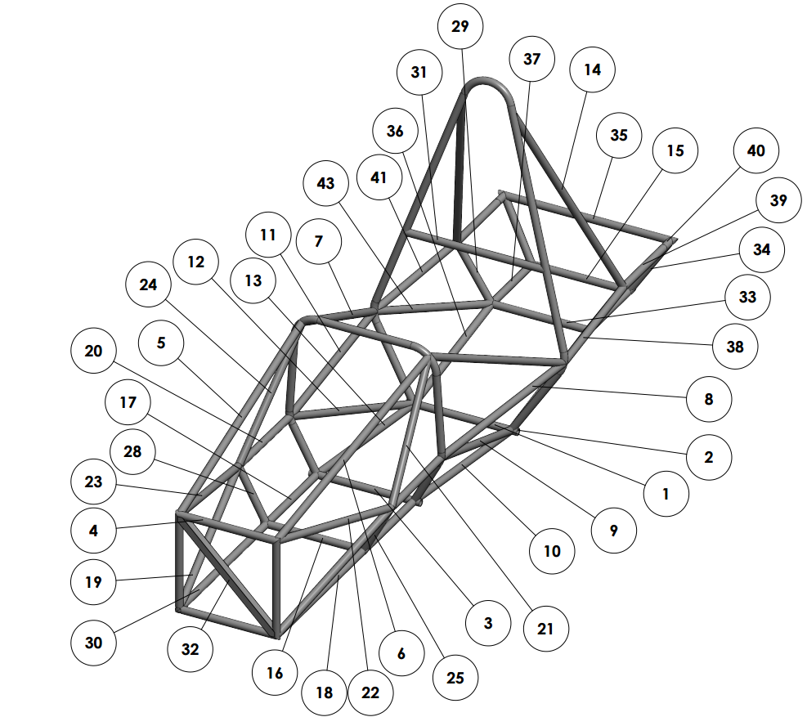
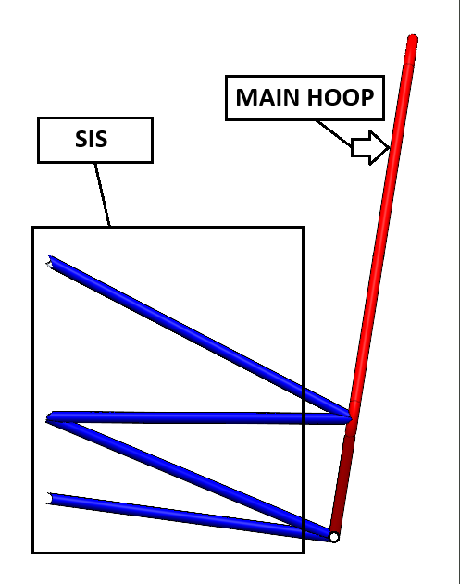
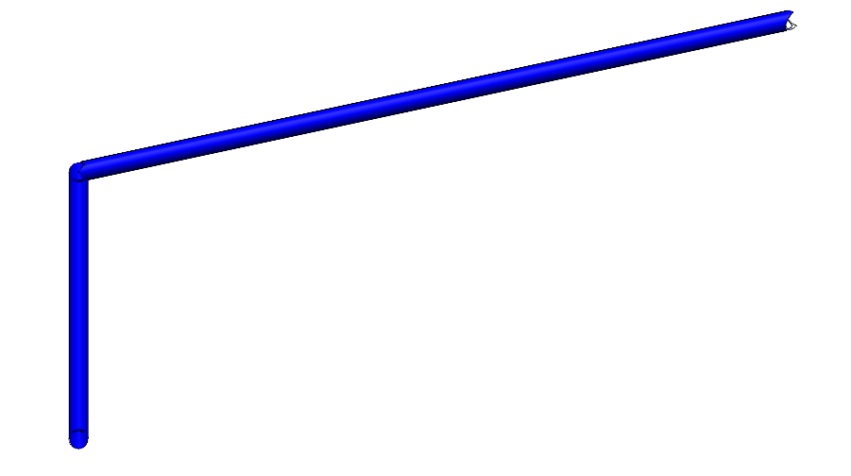
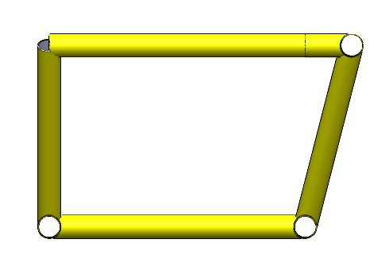
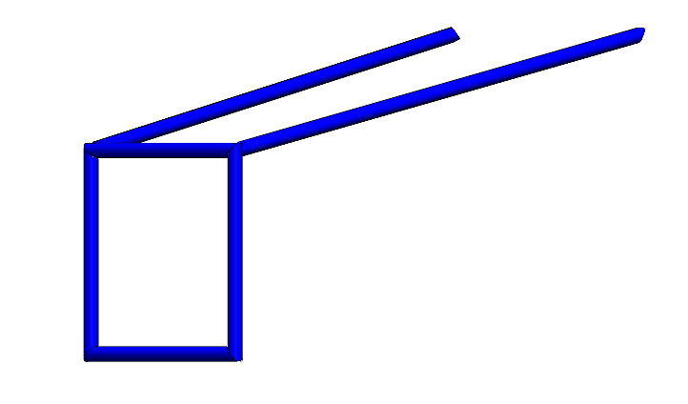
Chassis Frame Sub-Components
Front Bulkhead, SIS impact side with main hoop, Rear Suspension box images from the side, Frame Cut-List
CK

Slide 7
Design Validation - FMEA
Important Failure Points
Risk Trade-off Analysis
Weight vs. Safety
  Increased weight and safety features add stability of design but affects performance
Cost vs. Durability
  Higher quality products and material reduce failure likelihood
Complexity vs. Reliability
  Need to implement time into the equation, and if the product will function as needed without failure
Welds
Mounting Points(Suspension, Motor, Seatbelt/Seat, Aero)
Ergonomics(accessibility to instruments and controls, seat position/comfort, pedal box config.)
Floor and Side Panels
RM
Notes:
Welds – Design mitigation: not much design mitigation but will have to be diligent in visual inspection/maybe ultrasonic inspection
Mounting Points – FEA analysis will be done on mounting designs to ensure no high stress points, or over engineer design to be robust
Ergonomics – Current cockpit design improves driver comfort/performance, more dash space for instruments, design and will be improved and tweaked with driver feedback
Floor and Side Panels – Talk about Zeus fittings and how their design fits our needs well, improvement from last semester which was duct taped

Slide 8
Design Validation – Test Procedure
Important Failure Points:
Design and control tests:
Mounting points
Ergonomics( accessibility to instrument, driver controls, and seat position/comfort)*
Fire wall design( Anything driver touches cannot exceed 60 degrees Celsius)*
Roll hoop
Welds( stress or fatigue could influence a welds lifespan)*
Load/vibration testing to validate material strength of mounts.
Driver fit testing, ergonomic assessment, feedback from driver, ensure adjustability*
Mathematical calculations, Material testing, test reflective materials*
Static load testing, SolidWorks simulations, material inspection
Dye penetration test on welds, ensure sufficient welds on triangulated components*
BG
Notes:
Welds – Design mitigation: not much design mitigation but will have to be diligent in visual inspection/maybe ultrasonic inspection
Mounting Points – FEA analysis will be done on mounting designs to ensure no high stress points, or over engineer design to be robust
Ergonomics – Current cockpit design improves driver comfort/performance, more dash space for instruments, design and will be improved and tweaked with driver feedback
Floor and Side Panels – Talk about Zues fittings and how their design fits our needs well, improvement from last semester which was duct taped

Slide 9
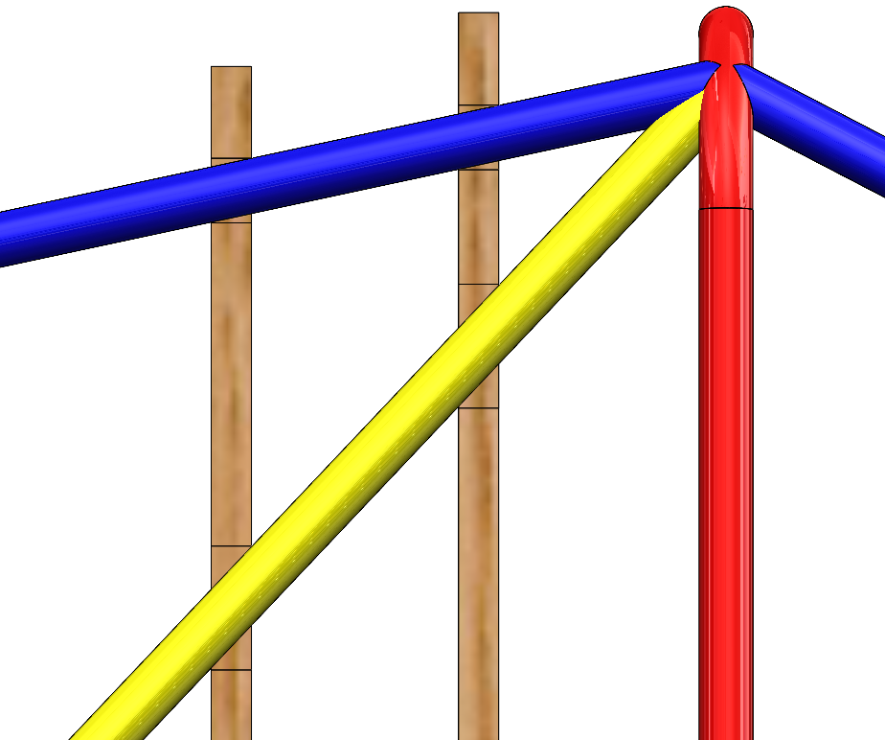
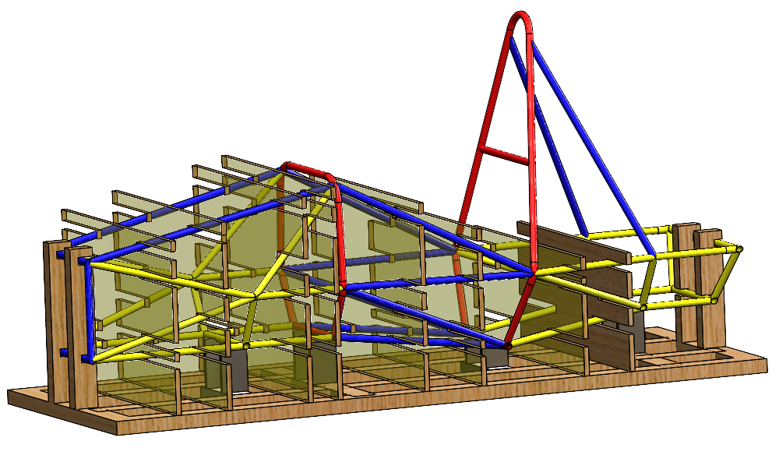
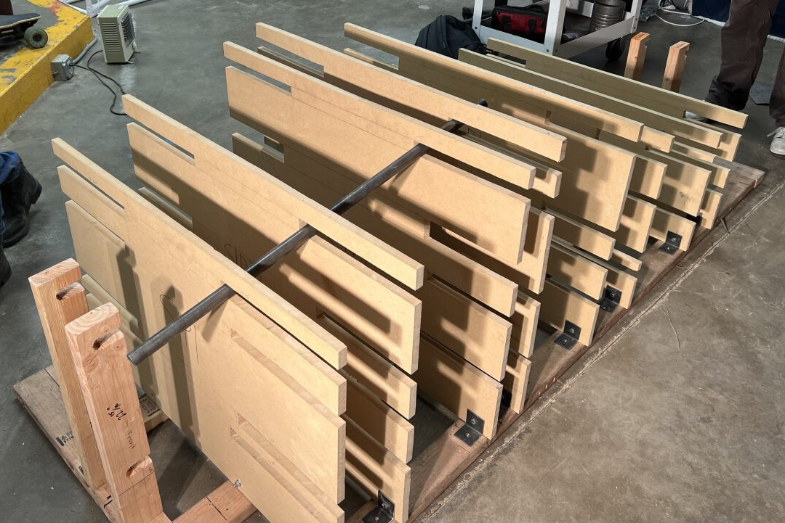
Engineering Calculations
2 MDF Section Planes per Diagonal Tube Section
Used SolidWorks tool “Intersection Curve” to find where tube ran through MDF
Manually adjusted cutouts to take into account thickness of MDF (.75”)
GR

Slide 10
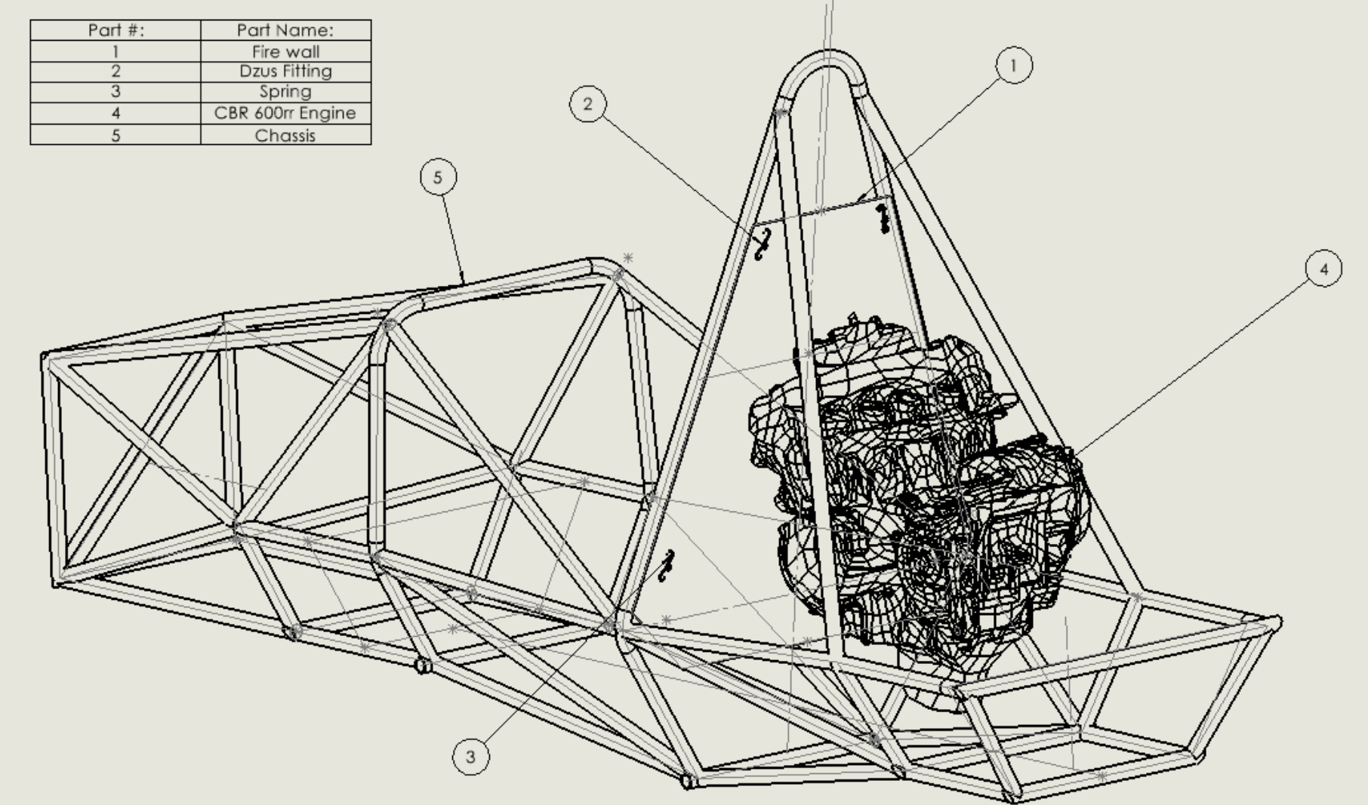
Engineering Calculations
Thermal Resistive Network:
Potential Materials (lowers emissivity):
  Steel (polished)
  Aluminum (Polished)
Thermal Conductivity:
  For steel: k = 50(w/m*k)
  For aluminum: k = 205(w/m*k)
Reflectivity:
  For steel: Reflects 30-40% of Radiation heat
  For aluminum: Reflects 85-90% of radiation heat
Heat coming from engine:
  While moving: 78.33 -79.4 degrees Celsius
  While stopped: 104.44 degrees Celsius
Assumptions:
  Prandtl number b/w 0.68 and 0.75 for temps b/w 0-100 degrees Celsius
  Turbulent flow around engine and cockpit (Re > 4000)
BG

Slide 11

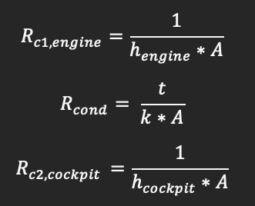
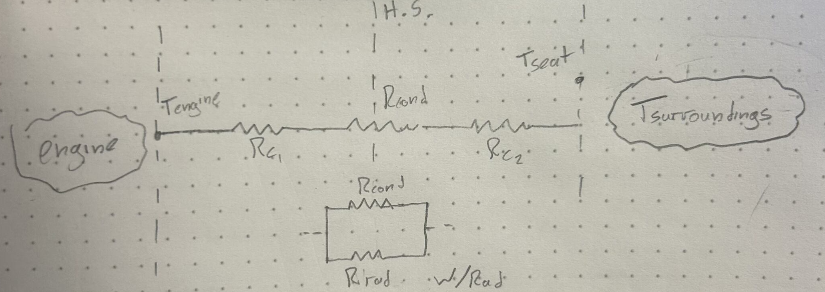
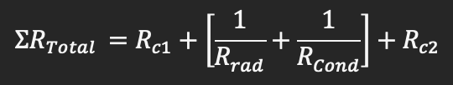



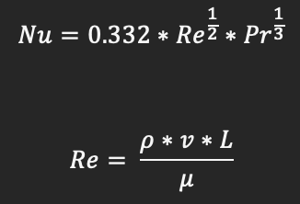

Engineering Calculations
Thermal resistive Network:
W/radiation
Variables:
  L = total height of sheet
  t= thickness
  A = area of sheet
  K = thermal conductivity
  h = convective heat transfer coefficient
  Nu = Nusselt number
  Re = Reynolds number
  P = density of air in flagstaff (0.968kg/m^3)
  T engine = 79.4 degrees Celsius
  T surroundings = 5 degrees Celsius
Ch. 7 in Heat transfer book
BG

Slide 12
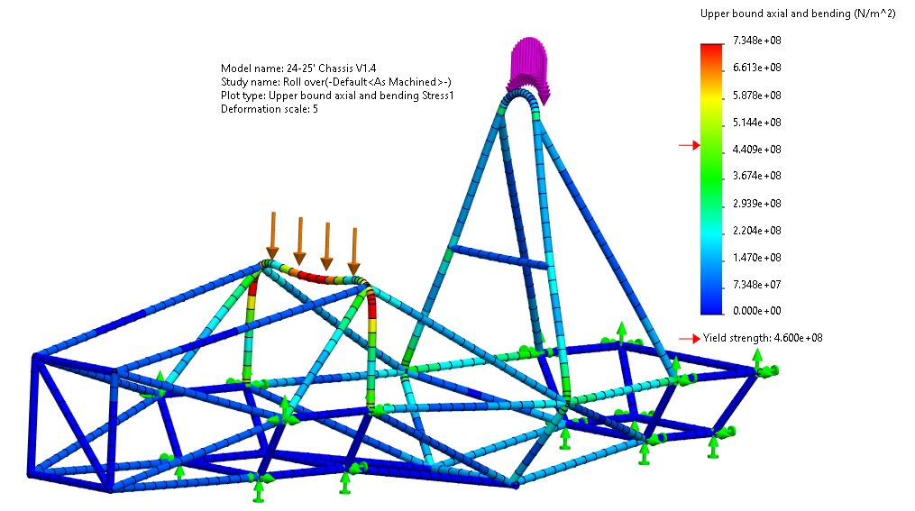
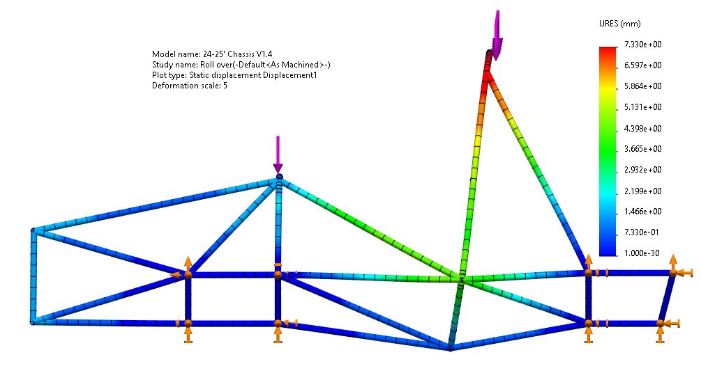
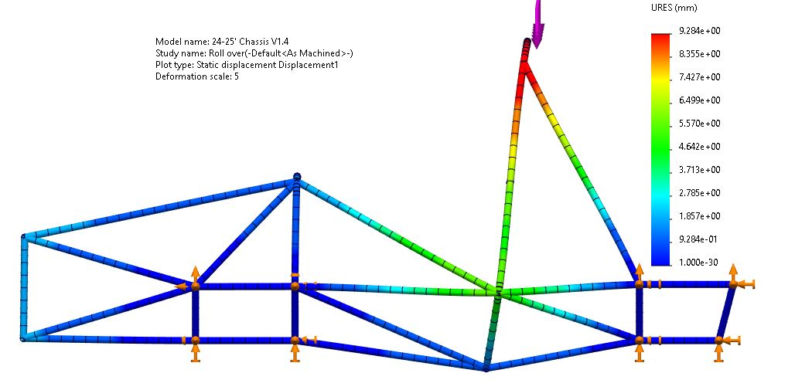
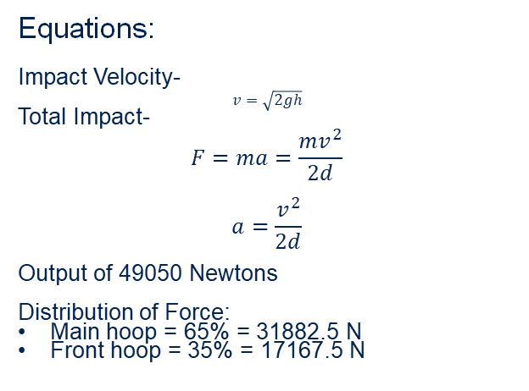
Engineering Calculations-Roll over Simulation
Rollover Impact
Variables:
m = 250kg
h = 1 meter
d = 5cm = 0.05m
  Deformation distance
  Typical yield deformation for steel
Equations:
Impact Velocity-
$$v=\sqrt{2gh}$$
Total Impact-
$$F=ma=\frac{mv^{2}}{2d}$$
$$a=\frac{v^{2}}{2d}$$
Output of 49050 Newtons
Distribution of Force:
Main hoop = 65% = 31882.5 N
Front hoop = 35% = 17167.5 N
Figure: Stress Plot
Figure: Displacement Plot
Figure: Displacement Plot with Force on Main hoop
RM
Notes:
An ER and CR requirement I will be looking into is the main hoop braces and front bulkhead mounting points for aero, how the aero will be supported and the forces it would put on the chassis.

Slide 13
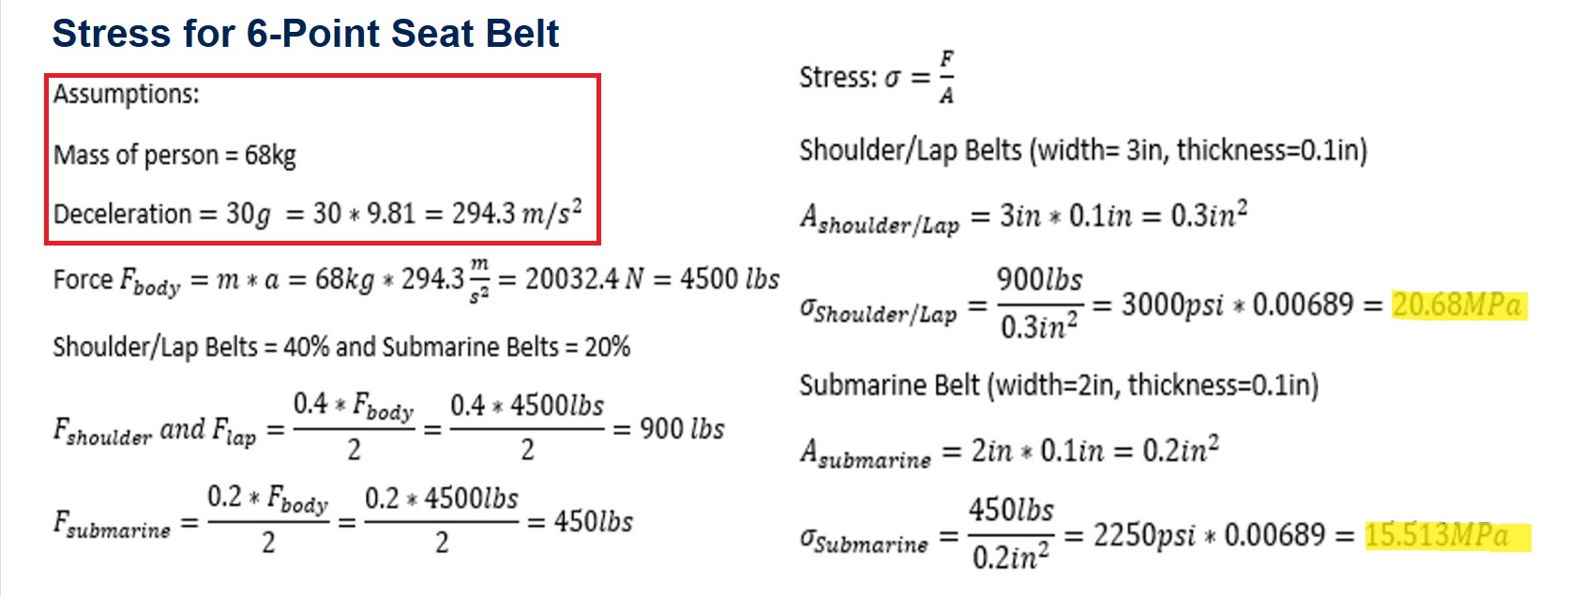
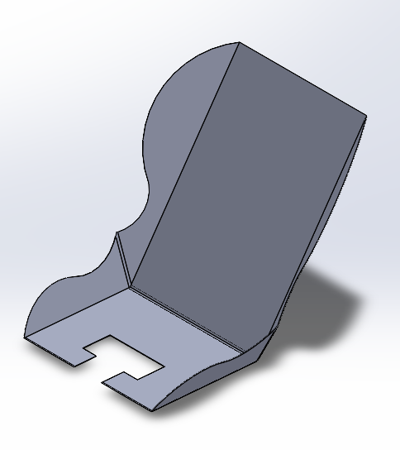
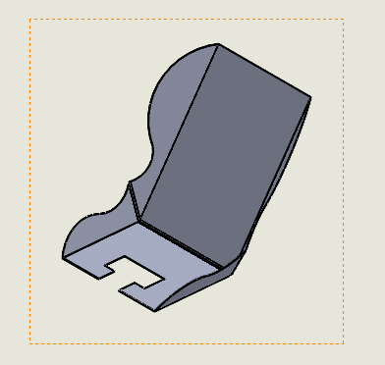
Engineering Calculations
Shoulder Mounts: mounted behind the shoulders at a point that creates an angle of about 30-45 degrees to the horizontal to prevent spinal compression.
Lap Belt Mounts: Mounted at the hip level, about 45 degrees relative to the direction of the load (inward toward the seat).
Submarine Belt Mounts: Positioned between the legs and attached securely to the floor, forming a 20-30 degree angle from the vertical, for maximum restraint.
Figure: Seat Prototype 2
AB

Slide 14
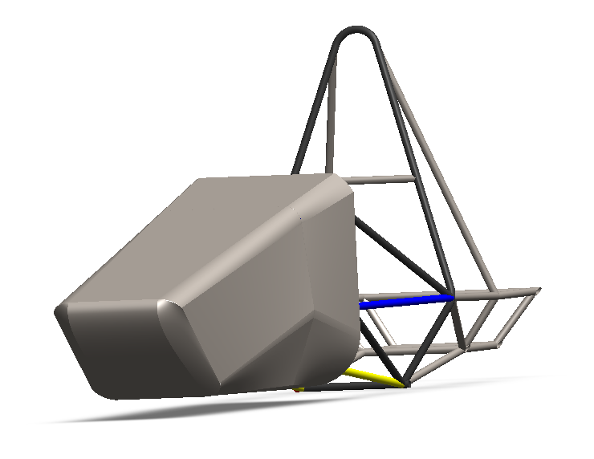
Engineering Design - Aero
Aerodynamics update
Nose cone design improvement with better overall shape
Close fit to the frame to allow for simpler mounting options
Utitlized surface lofting from sketches rather than extrusions for more seamless design
Working with Ansys Fluent for better analysis of the nose cone and to be able to choose between different designs
After analysis, the mold will be done using styrofoam which will be cut with hot wire and shaped by sanding
Planning to meet with Nova Kinetics soon to go over production of our aerodynamic components
Figure: Nose Cone Prototype
CK

Slide 15
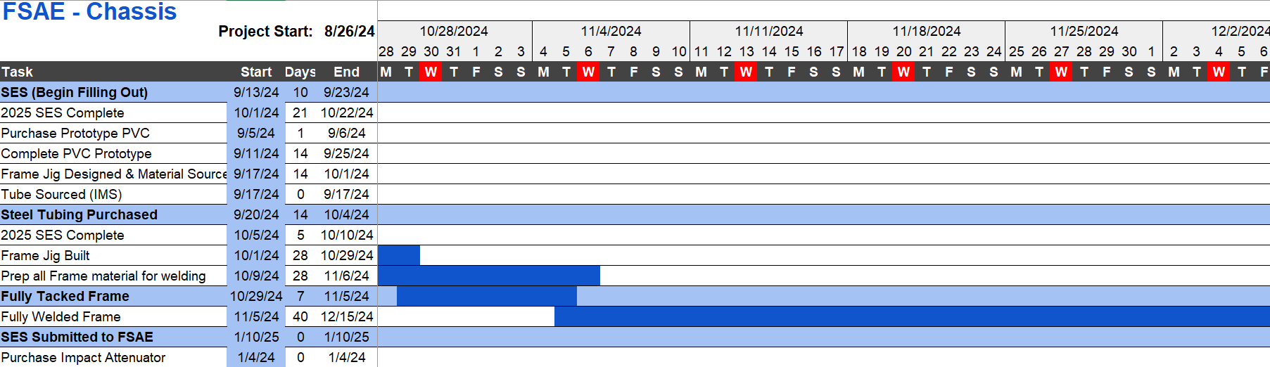
Schedule & Gantt Chart
PHOTO
Behind Schedule
  JIG Building
  Tube Prepping
Accelerate Tube Prepping
Tack tube members that are not coped
NEXT STEPS
GR
Add a descriptive caption here.

Slide 16
Budget
Spent
Item | Description | Qty. | Vendor | Total Cost
Size A Tube | 4130 1" x .095" x 144" Round Tubing | 2 | IMS | $211.94
Size B Tube | 4130 1" x .065" x 288" Round Tubing | 2 | IMS | $468.67
Size C Tube | 4130 1" x .049" x 8' Round Tubing | 7 | Online Metals | $565.94
IMS Shipping | Transportation Gas |  | Chevron/QT | $166.48
Prototyping PVC 1" Pipe | 1" x 10' PVC40 PEPIPE | 10 | Home Depot | $74.02
Prototyping Duct Tape | 3M White Duct Tape 55YD 1PK | 2 | Home Depot | $19.61
JIG | 3/4" MDF Board 48" x 96" | 3 | Home Depot | $160.41
JIG | Hex Nut Zinc 5/16 | 40 | Home Depot | $6.99
JIG | Hex Bolt Zinc 5/16 x 1-1/2 | 31 | Home Depot | $12.52
JIG | Lock Washer Galv 5/16 | 31 | Home Depot | $10.83
JIG | 1-1/4" Construction Screw 1lb | 1 | Home Depot | $11.44
JIG | Oil-Based Paint Pen 5pk | 1 | Home Depot | $14.72
JIG | Digital Angle Gauge | 1 | Home Depot | $32.72
 |  |  | Total | $1,756.28
Anticipated
Item | Description | Qty. | Vendor | Total Cost
Square Tube | 4130 1'' x .065 x 2' Square Tube | 1 | Online Metals | $95.76
Impact Attenuator | IMPAXX™ 700 foam Attenuator | 1 | Rollbar Padding | $210.00
Harness | SFI 16.1 6pt Harness | 1 | Summit Racing | $179.00
 |  |  | Total | $484.76
PHOTO
Total Available | $6,058.24
Anticipated Expenses | $484.76
Actual Expenses to Date | $1,756.28
Resulting Balance | $4,301.96
GR
Add a descriptive caption here.

Slide 17

Thank You!

